Slide 1
Intermediate Coding Week 20
More Recursion: Backtracking

Slide 2
String methods
Method name | Description
indexOf(str) | index where the start of the given string appears in this string (-1 if not found)
length() | number of characters in this string
substring(index1, index2) or substring(index1) | the characters in this string from index1 (inclusive) to index2 (exclusive); if index2 is omitted, grabs till end of string
toLowerCase() | a new string with all lowercase letters
toUpperCase() | a new string with all uppercase letters
charAt(index) | the character at a specific index
These methods are called using the dot notation:
String s = “Hello World!”;
System.out.println(s.length()); // 11

Slide 3

Recursive Backtracking

Slide 4
Permutations
Write a method permute that accepts a string as a parameter and outputs all possible rearrangements of the letters in that string. The arrangements may be output in any order.
Example: permute("MARTY") outputs the following sequence of lines:
MARTY MARYT MATRY MATYR MAYRT MAYTR MRATY MRAYT MRTAY MRTYA MRYAT MRYTA MTARY MTAYR MTRAY MTRYA MTYAR MTYRA MYART MYATR | MYRAT MYRTA MYTAR MYTRA AMRTY AMRYT AMTRY AMTYR AMYRT AMYTR ARMTY ARMYT ARTMY ARTYM ARYMT ARYTM ATMRY ATMYR ATRMY ATRYM | ATYMR ATYRM AYMRT AYMTR AYRMT AYRTM AYTMR AYTRM RMATY RMAYT RMTAY RMTYA RMYAT RMYTA RAMTY RAMYT RATMY RATYM RAYMT RAYTM | RTMAY RTMYA RTAMY RTAYM RTYMA RTYAM RYMAT RYMTA RYAMT RYATM RYTMA RYTAM TMARY TMAYR TMRAY TMRYA TMYAR TMYRA TAMRY TAMYR | TARMY TARYM TAYMR TAYRM TRMAY TRMYA TRAMY TRAYM TRYMA TRYAM TYMAR TYMRA TYAMR TYARM TYRMA TYRAM YMART YMATR YMRAT YMRTA | YMTAR YMTRA YAMRT YAMTR YARMT YARTM YATMR YATRM YRMAT YRMTA YRAMT YRATM YRTMA YRTAM YTMAR YTMRA YTAMR YTARM YTRMA YTRAM
Notes:
interesting variation: Output only the *unique* rearrangements. For example, permute("GOOGLE") has two Os, but swapping them in order produces the same string, which shouldn't appear twice in the output.

Slide 5
Examining the problem
Think of each permutation as a set of choices or decisions:
Which character do I want to place first?
Which character do I want to place second?
...
solution space: set of all possible sets of decisions to explore
We want to generate all possible sequences of decisions.
for (each possible first letter):
for (each possible second letter):
for (each possible third letter):
...
print!
This is called a depth-first search

Slide 6
Decision trees
chosen | available
 | M A R T Y
M | A R T Y
A | M R T Y
...
M A | R T Y
M R | A T Y
M T | A R Y
M Y | A R T
...
...
M A R | T Y
M A T | R Y
M A Y | R T
...
M Y A | R T
...
...
M A R T | Y
M A R Y | T
M A Y R | T
M A Y T | R
M A R T Y
M A R Y T
M A Y R T
M A Y T R

Slide 7
Backtracking
backtracking: A general algorithm for finding solution(s) to a computational problem by trying partial solutions and then abandoning them ("backtracking") if they are not suitable.
a "brute force" algorithmic technique (tries all paths; not clever)
often (but not always) implemented recursively
Applications:
producing all permutations of a set of values
parsing languages
games: anagrams, crosswords, word jumbles, 8 queens
combinatorics and logic programming

Slide 8
Backtracking algorithms
A general pseudo-code algorithm for backtracking problems:
explore(choices):
if there are no more choices to make: stop.
else:
Make a single choice C from the set of choices.
Remove C from the set of choices.
explore the remaining choices.
Un-make choice C.
Backtrack!

Slide 9
Backtracking strategies
When solving a backtracking problem, ask these questions:
What are the "choices" in this problem?
What is the "base case"? (How do I know when I'm out of choices?)
How do I "make" a choice?
Do I need to create additional variables to remember my choices?
Do I need to modify the values of existing variables?
How do I explore the rest of the choices?
Do I need to remove the made choice from the list of choices?
Once I'm done exploring the rest, what should I do?
How do I "un-make" a choice?

Slide 10
Permutations revisited
Write a method permute that accepts a string as a parameter and outputs all possible rearrangements of the letters in that string. The arrangements may be output in any order.
Example: permute("MARTY") outputs the following sequence of lines:
MARTY MARYT MATRY MATYR MAYRT MAYTR MRATY MRAYT MRTAY MRTYA MRYAT MRYTA MTARY MTAYR MTRAY MTRYA MTYAR MTYRA MYART MYATR | MYRAT MYRTA MYTAR MYTRA AMRTY AMRYT AMTRY AMTYR AMYRT AMYTR ARMTY ARMYT ARTMY ARTYM ARYMT ARYTM ATMRY ATMYR ATRMY ATRYM | ATYMR ATYRM AYMRT AYMTR AYRMT AYRTM AYTMR AYTRM RMATY RMAYT RMTAY RMTYA RMYAT RMYTA RAMTY RAMYT RATMY RATYM RAYMT RAYTM | RTMAY RTMYA RTAMY RTAYM RTYMA RTYAM RYMAT RYMTA RYAMT RYATM RYTMA RYTAM TMARY TMAYR TMRAY TMRYA TMYAR TMYRA TAMRY TAMYR | TARMY TARYM TAYMR TAYRM TRMAY TRMYA TRAMY TRAYM TRYMA TRYAM TYMAR TYMRA TYAMR TYARM TYRMA TYRAM YMART YMATR YMRAT YMRTA | YMTAR YMTRA YAMRT YAMTR YARMT YARTM YATMR YATRM YRMAT YRMTA YRAMT YRATM YRTMA YRTAM YTMAR YTMRA YTAMR YTARM YTRMA YTRAM
Notes:
interesting variation: Output only the *unique* rearrangements. For example, permute("GOOGLE") has two Os, but swapping them in order produces the same string, which shouldn't appear twice in the output.

Slide 11

Problems

Slide 12
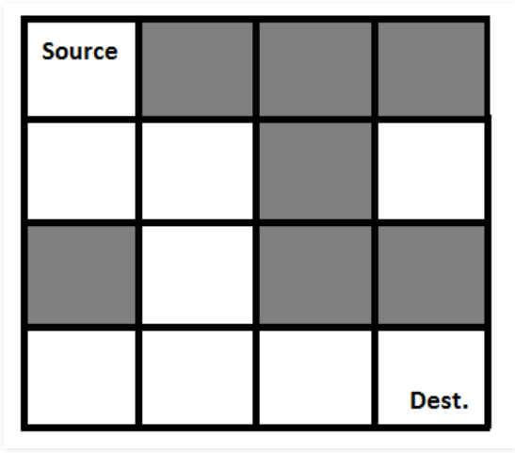
Question 1
Given a maze represented by an array of integers with a 1 representing a wall and a 0 representing empty space, write a method that returns whether it is possible to reach the bottom-right corner from the top-left corner.
Example maze:
0111
0010
1011
0000
For this maze, it is possible to reach the bottom right from the top left.
The maze represented where gray blocks are “walls” or “1”s while white blocks are “empty space” or “0”s.

Slide 13
Question 2
How many integers between 100 and 999, inclusive, have the property that some permutation of its digits is a multiple of 11 between 100 and 999? For example, both 121 and 211 have this property.
This is a question from an AMC 10 test! Using computers can often make math easier ☺.

Slide 14
Question 3
Write a method sumOfSquares that uses recursive backtracking to find whether a positive integer can be expressed as a sum of unique squares (none of the squares should be repeated).
For example, sumOfSquares(200) should return true, since 200 can be expressed as a sum of unique squares in multiple ways, a few of which are below:
2^2+14^2
6^2+8^2+10^2
1^2+3^2+4^2+5^2+7^2+10^2
However, sumOfSquares(7) should return false, since 7 cannot be expressed as a sum of unique squares.

Slide 15
Question 4
You, Orange Otto, have just entered the world's easiest maze. You start in the northwest cell of an N by N grid of unit cells, and you must reach the southeast cell. You have only two types of moves available: a unit move to the east, and a unit move to the south. You can move into any cell, but you may not make a move that would cause you to leave the grid.
However, your rival, Blue Betty, has already solved the maze before you, using the same rules described above!
As an original thinker, you do not want to reuse any of Betty’s moves. Specifically, if her path includes a unit move from some cell A to some adjacent cell B, your path cannot also include a move from A to B. (it is OK for your path to visit A or visit B, as long as you do not go from A to B). Please find such a path.

Slide 16
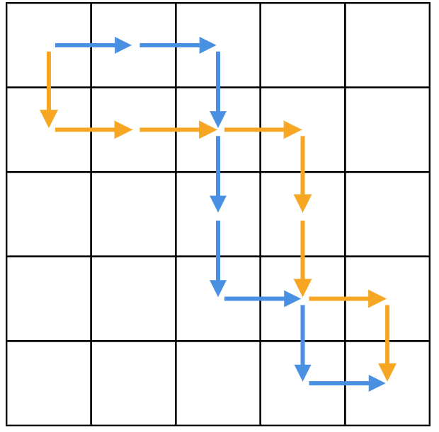
Question 4 Continued
Example: N=5 and Betty’s path is EESSSESE
One possible solution is SEEESSES.
Can you think of a way to solve this with backtracking?
How about without backtracking?
This question is adapted from a Google Code Jam problem!

Slide 17
Question 5
LeetCode is a great source of programming-interview style questions. If you like to do coding problems, want to practice for a programming interview, or want to do more review for the things you’ve learned, it’s a great source!
Here’s a LeetCode problem about recursive backtracking:
https://leetcode.com/problems/predict-the-winner/
Give it a shot!

